Slide 1
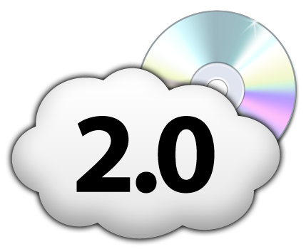
Hybrid Infrastructure Hosting
Clouds + Dedicated + Colocated

Slide 2

Contents
What is Cloud Computing?
Benefits – Cloud & Hybrid Hosting
What can Clouds do for ME?
When to use the Cloud?
Landscape & Differentiators
HYBRID CLOUDS

Slide 3

How are YOU doing your Hosting now?
Self-Hosted
  How do you do Cooling, Power, Security, etc?
  Is it cost-effective?
Shared
  Don’t you want to grow easily?
Dedicated
  Can you scale?
  How long to deploy?
Colocation
  Premium pricing?
Clouds
  Do you have full control?
  Are you satisfied with features?

Slide 4
What is Cloud Computing?

Slide 5
Cloud Computing is…
Programmatic
Abstraction
Shared
Over the Internet
Pay as you go
Self-service
Use only what you need
Scalable
…On-Demand!

Slide 6
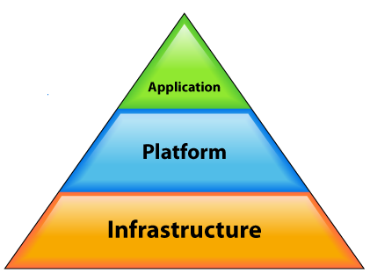
Cloud Computing Hierarchy of Service
SaaS – Software as a Service
PaaS– Platform as a Service
IaaS – Infrastructure as a Service

Slide 7
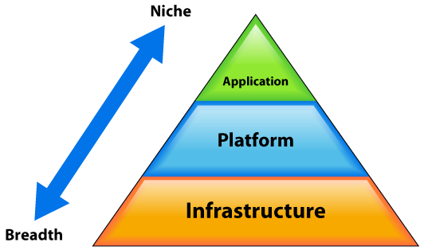
The “Cloud Pyramid”
Cloud Services economy is a pyramid
Layers equate structure
Building blocks:
  Infrastructure-as-a-Service (IaaS)
  Platform-as-a-Serice (PaaS)
  Applications (SaaS)
Breadth vs. Niche

Slide 8





The "Cloud Pyramid"
Describes Cloud Services Economy
Building blocks: IaaS -> PaaS -> SaaS
Google
App Engine

Slide 9
Benefits
Cloud Computing & Hybrid Hosting

Slide 10
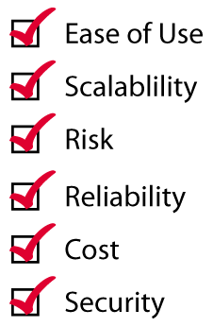

Benefits of the Cloud
Not confined to Small Discipline of IT
All aspects of Computing & IT
  Servers
  Load Balancers
  Firewalls
  Networks
  Storage
  Software
Do Smarter!

Slide 11
Cloud computing economics
30,000,000 servers are not in the cloud. Yet.
  Average server 10% utilized.
  Not green.
  Wastes green.
CapEx to OpEx
Use only what you need
    Turn stuff off
    Scale easily

Slide 12
Cloud vs. Physical Servers
Over-spending on Infrastructure!
Over-spending on Infrastructure!
Demand
Over-spending on Infrastructure!
Time

Slide 13

Cost of Ownership Myth
Myth - “It’s more expensive in the Cloud”
  “Cheaper to buy your gear and & divide by 36 months”. AKA “The McKinsey Myth”
Reality – Nobody can estimate their true needs 3 years out
  Cloud pricing coming down

Slide 14
What can Clouds do for Me?
Helping Startups, SMBs, SMEs, Gov’t, Enterprise

Slide 15

Do Just About Anything!
QA/Dev/Demo/Training environments
Disaster Recovery
Replacement for existing physical infrastructures
Statistical Analysis & Bulk Processing
…the sky’s the limit!
Why are these suitable for cloud?
You “own” your complete environment.
Turn off at night, easy to deploy & replicate

Slide 16
When to use
Best scenarios to use Cloud Computing

Slide 17

Not a Single Solution
Pure Cloud vs. Hybrid
  Dedicated or Colocated Back-end
    High I/O performance
    Compliance
    Managed Services
  Cloud Front-end
    Horizontal scalability
    Dynamic
    Self-Service

Slide 18
Landscape & differentiators
The competitive landscape & key differentiators

Slide 19
GoGrid vs. Amazon Web Services
Cloudcenters
  GoGrid is established leader
  Datacenter model ‘in-the-sky’
  Standards-based datacenter-like infrastructure
    Real, contiguous, persistent IPs and VLANs
    Persistent data storage
Infrastructure Web Services
  AWS is established leader
  Web service model, pick and choose services ‘a la carte’
    Great for developers
  Proprietary interfaces

Slide 20
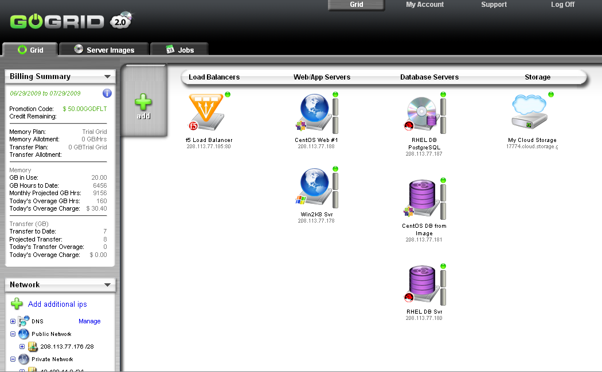
What is GoGrid?
Private Server Images!
Public & Private Clouds
Windows & Linux Servers in the Cloud
Web-based Portal & API
FULL root or Admin access
Connect via SSH or RDC
Free f5 Load Balancing
Free Dedicated Public & Private Networks/IP’s
Free Support

Slide 21

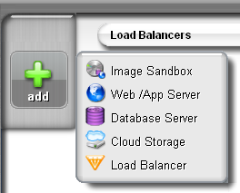
GoGrid v2.0!
Announced for CloudWorld 2009!
MyGSIs = Private Server Images
  Imaging of servers
  Vertical & horizontal scalability
  Cloning
  Store images cheaply on Cloud Storage
  Easy 3-Step Process
    Create Image Sandbox
    Configure & Run Prep Script
    Save Image

Slide 22
GoGrid Portal

Slide 23
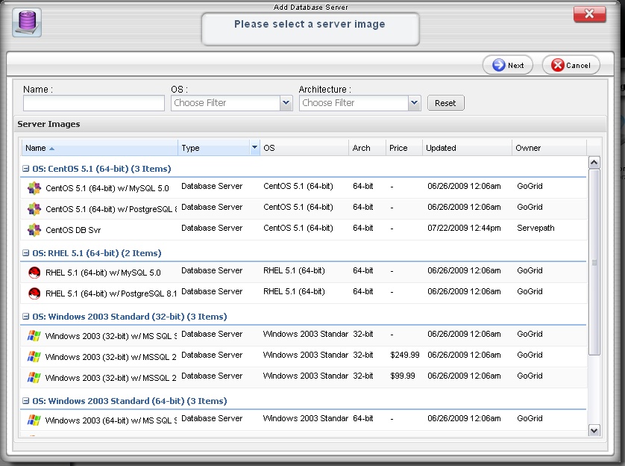
GoGrid Portal – Add a Server

Slide 24
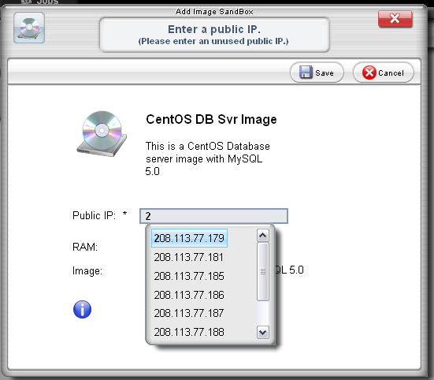
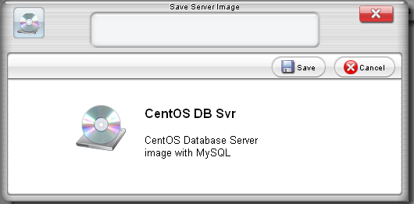
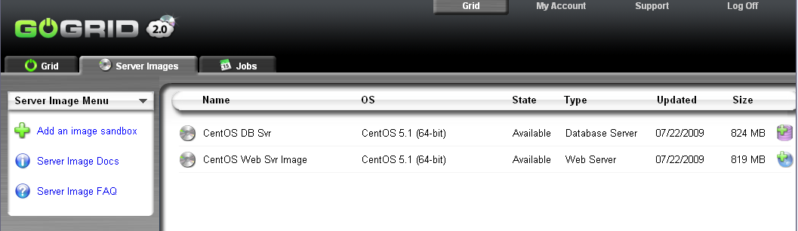
GoGrid - MyGSIs

Slide 25

Hardware “in the Cloud”
Only GoGrid currently delivers Cloud Computing with:
  Real, contiguous blocks of static IP addresses
  Real VLANs (Public/Private)
  Persistent Storage
  Windows 2008 and SQL Server
  Included f5 enterprise-grade load balancing
Support for “hybrid” cloud / dedicated
  GoGrid “Cloud Connect”
    PCI compliance with dedicated DB server
    Custom physical hardware managed or colocated
AJAX GUI & Open API standard specification for “cloudcenters”

Slide 26
Hybrid Clouds
Cloud + Dedicated + Colocated

Slide 27
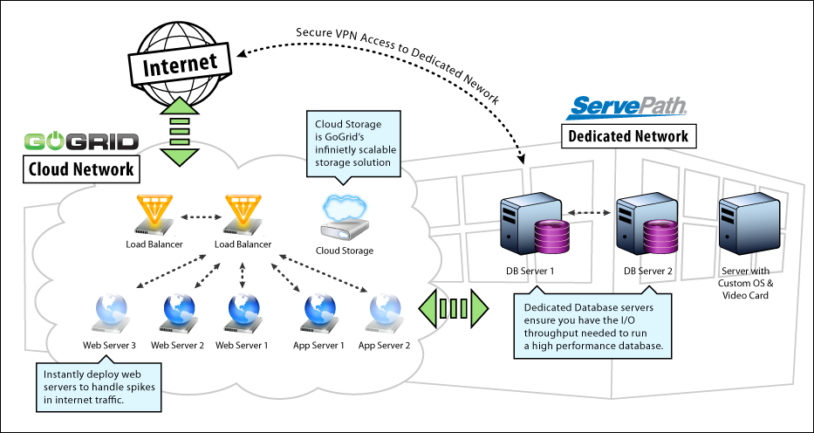
“Cloud Connect” = Hybrid Clouds
Easy to deploy Cloud Services & Infrastructure
Links Cloud with “Bare Metal”

Slide 28
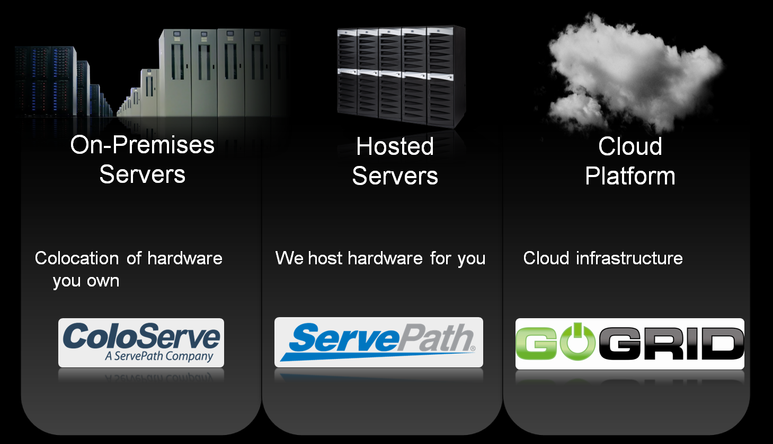
Our “Platform Continuum”

Slide 29
Continued success with Hybrid Solutions
Hybrid Cloud / Physical Hardware Solutions
  Dedicated or Colocated Back-end
    High I/O performance
    Compliance
    Managed Services
  Cloud Front-end
    Horizontal scalability
    Dynamic
    Self-Service

Slide 30

Macys.com QA Case Study
Built by GoGrid partner Grid Dynamics
QA infrastructure for Macys.com content updates
Hybrid solution:
  Colocated Macy’s security hardware
  Private Internet connection back to Macys datacenter
  Private backend connection between colocated hw and GoGrid
  GoGrid Public IPs disabled for effective private cloud

Slide 31
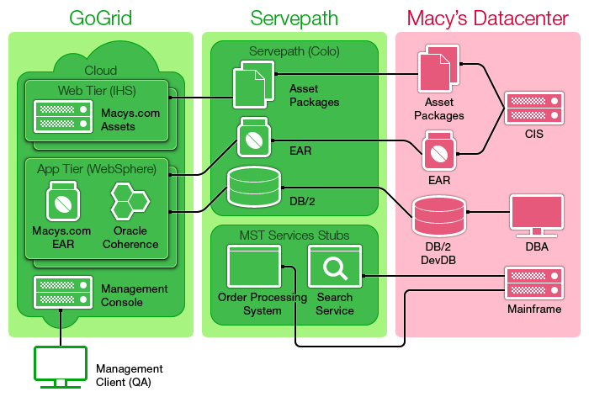
Macys.com QA Case Study (continued)

Slide 32
Macys.com QA Case Study (continued)
QA team can now control their environment
  Reduced testing server deployment from 1 day to 1 hour
  Eliminated QA bottlenecks due to IT resource constraints
Huge Operational Cost Savings.
  Under mandate for no new capex, limited to 6 QA environments before the GoGrid on-demand solution was implemented
New QA improvements now possible
  Now testing 2-3 weeks of releases instead of 1 week

Slide 33
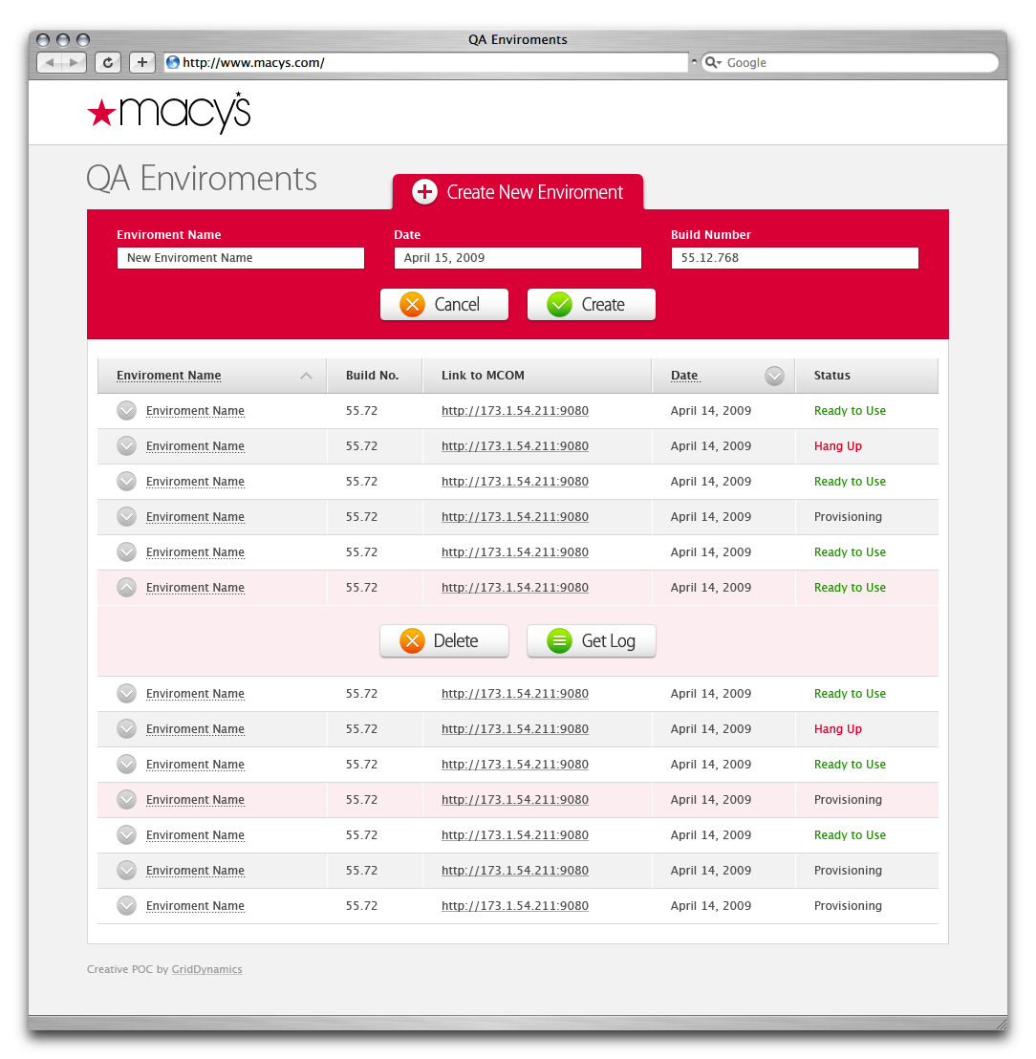
Macys.com QA Case Study (continued)
Before:
  Limited to 6 staging environments
  Frequent content and promotional updates caused QA bottlenecks
After:
  Self-service, on demand deployment of environments in < 1 hour
  More flexibility and huge cost savings for QA

Slide 34

Summary
CapEx is dead!
Demand to use the Cloud!
Trial GoGrid for free!
$100 Coupon code → GGPLO

Slide 35
Contact Information
Paul Lancaster
  Channel Partner Manager of GoGrid & ServePath
  Email: plancaster@gogrid.com
  Twitter: @paullancaster
Michael Sheehan
  Technology Evangelist for GoGrid & ServePath
  Email: michael@gogrid.com
  Twitter: @hightechdad
Site: http://www.GoGrid.com
Blog: http://blog.GoGrid.com
Wiki: http://wiki.GoGrid.com
Twitter: @GoGrid

